Slide 1
Open Source JobScheduler
Software- und Organisations-Service
JobScheduler
in a Nutshell
Product Overview
Software- und Organisations-Service GmbH www.sos-berlin.com

Slide 2
Introduction to JobScheduler
Open Source JobScheduler
The JobScheduler is a workload automation product that is used to launch scheduling objects, such as jobs, job chains and orders, when time, file or calendar events occur.
The JobScheduler provides solutions from simple to complex scheduling scenarios and is available with open source and commercial licenses.
The JobScheduler has been under continual development since 2005 and has a mature status. The JobScheduler was recognized by Gartner Inc. with a placement in their Magic Quadrant for workload automation.

Slide 3
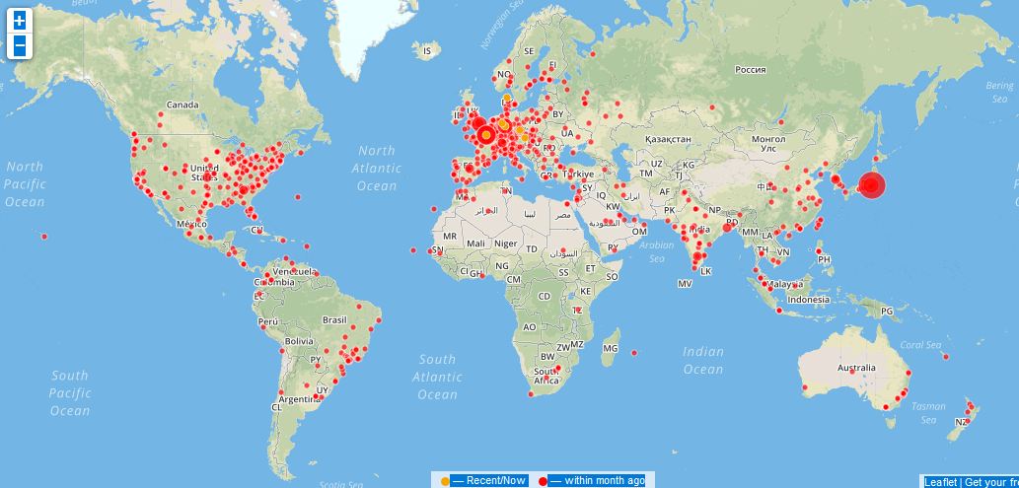
Open Source Users and Commercial Customers
JobScheduler worldwide
About us SOS GmbH was founded in 1983, we specialized in office automation, develop-ment of heterogeneous software programs and the provision of services and support.
In 2005 SOS GmbH introduced Dual Licen-sing (Open Source & commercial licensing) for JobScheduler and in 2011 for YADE -Managed File Transfer.
Today SOS GmbH continues with the on-going development of its open source products, the delivery of services and support to their customers worldwide.
Open source users in more than 100 countries
191 commercial customers in 27 countries

Slide 4
Topics
Contents
Architecture
Components
Platforms
Security
Use Cases
Cross-Platform Scheduling
File Watching
File Transfer
Features
Interfaces
Key Features
High Availability
Agent Cluster
Master Cluster

Slide 5
JobScheduler Components
Architecture
More Information
JobScheduler Master
JobScheduler Universal Agent
User Interfaces:
JOC Cockpit
JOE Graphical Editor
JobScheduler Master
processes objects, such as jobs, job chains, orders and schedules
Job Scheduler Universal Agent
execute jobs on any machines in the network
User Interfaces
JOC Cockpit: web-based interface for operating and monitoring JobScheduler in near real-time
JOE: graphical editor for JobScheduler objects such as jobs, job chains, orders and schedules

Slide 6
Architecture: Components
JOC Cockpit / Web Service / Master / Agent
JOC Cockpit
The JOC Cockpit is a user interface for job control with browsers
Users access the Master using a Web Service that performs authentication and authorization – optionally against an LDAP directory
Interfaces
The PowerShell Command Line Interface and External Applications use the same Web Service for access to a JobScheduler Master
Authorization is available for individual requests to the JobScheduler Master
Master / Agent
The JobScheduler Master executes tasks and orchestrates Agents
Agents are deployed on top of existing servers running the programs and scripts that should be scheduled
JOC Cockpit
User Interface
User Interface for job control
PowerShell CLI
Scripting Interface
Programming Interface
External Applications
LDAP
Directory
JobScheduler Web Service
Authentication and Authorization
JobScheduler Master
JobScheduler Master
JobScheduler Master
Agents
Agents
Agents
Database
Database Access
Database Access
Database Access

Slide 7
Architecture: Platforms
Platforms and Databases
More Information
Supported Platforms
Supported Databases
Supported Platforms and Databases
JOC Cockpit & Web Service
Windows and Linux
JobScheduler Master
Windows and Linux
JobScheduler Universal Agent
Windows and Linux
Solaris, AIX, HP-UX, Mac OS
and any other platform that supports a Java Virtual Machine
Databases
Oracle, SQL Server
MariaDB, MySQL and PostgreSQL

Slide 8
Architecture: Platforms
Supported Platforms
Cockpit / Web Service
The JOC Cockpit and REST Web Service are available for Windows and Linux
Master / Agent
JobScheduler Master is available for Windows and Linux
JobScheduler Agents are available for any platform that supports a Java Virtual Machine
Database
The JobScheduler REST Web Service and Master use a data- base on any platform
Jobs
Jobs can be executed locally on the Master
Jobs can be executed on any JobScheduler Universal Agent
JobScheduler JOC Cockpit
Windows
JobScheduler Web Service
Windows
JobScheduler JOC Cockpit
Linux
JobScheduler Web Service
Linux
Database
Database access
JobScheduler Master
Windows
Enables job execution:
on JobScheduler Master instances
on JobScheduler Agents for any platform
JobScheduler Master
Linux
Works with supported databases including:
Oracle
SQL Server
MariaDB/MySQL
PostgreSQL
JobScheduler
Agent Windows
JobScheduler
Agent Linux
JobScheduler
Agent Solaris
JobScheduler
Agent AIX
Works with any platform that supports a Java Virtual Machine
JobScheduler
Agent HP-UX
JobScheduler
Agent Mac OS
JobScheduler
Agent Docker
JobScheduler
Agent Raspberry Pi
JobScheduler
Agent ... any platform

Slide 9
Architecture: Security
JOC Cockpit / Web Service / Master / Agent
Users Network Zone with restricted user access
Limited access that requires authentication
Any connection to a Master is authenti-cated by the Web Ser-vice that can be con-figured to use LDAP
Use of HTTPS for connections can be enforced
Network Zone without user access
Master and Agent instances are oper-ated in this zone with-out direct user access
The Master instances are accessed ex-clusively by the Web Service
Agent instances are exclusively accessed by Master instances
Network Zone
with limited
user access
JOC Cockpit
User Interface
HTTP / HTTPS
HTTP / HTTPS
External Applications
PowerShell CLI
HTTP / HTTPS
HTTP / HTTPS
LDAP
Directory
JobScheduler Web Service
LDAP proprietary protocol
Database proprietary protocol
Network Zone
without
user access
HTTP / HTTPS
JobScheduler Master
HTTP / HTTPS
JobScheduler Master
JobScheduler Master
Agents
Agents
Agents
Database
Database proprietary protocol
Database proprietary protocol
Database proprietary protocol

Slide 10
Use Cases
Samples of Real World Use Cases
Real World
Use Cases
Cross-Platform Scheduling
Processing with Agents across Platforms
Agentless Scheduling across Platforms
File Watching
Watching incoming files on a Master
Remote File Watching with Agents
File Transfer
Server-2-Server file transfer with YADE
Push Files to Internet via Jump Host
Pull Files from Internet via Jump Host

Slide 11
Use Case: Cross-Platform Scheduling
Processing with Agents across Platforms
Real World
Use Cases
Use Case
The customer operates servers with Windows, Linux, Solaris and AIX
Jobs with dependencies have to be executed on the different servers
Solution
Remote execution with Universal Agents
A JobScheduler Master for Windows optionally executes jobs locally and orchestrates four Agents
Job dependency is configured with Master who contacts Agents to execute jobs
Benefits
JobScheduler covers all required platforms
Job dependencies for multi-platform execution can be configured
Single point of configuration & operation
Zero configuration for Universal Agents and easy deployment to large clusters
JobScheduler Master
Windows
Master contacts Agents to execute jobs
Master collects log output and execution results
Sequence of jobs configured with the JobScheduler Master
Job Chain
Job Chain
Job 1
Job 2
Job 3
Job 4
JobScheduler
Agent Linux
JobScheduler
Agent Windows
JobScheduler
Agent Solaris
JobScheduler
Agent AIX

Slide 12
Use Case: Cross-Platform Scheduling
Agentless Scheduling across Platforms
Use Case Scenario
Use Case
The customer operates servers with Windows, Linux, Solaris and AIX
Jobs with dependencies have to be executed on the different servers
Solution
A JobScheduler Master for Windows executes jobs locally and orches-trates execution on three servers by SSH
The job dependency is configured with the Master who contacts Agents to execute jobs
Benefits
No software installation is required for job execution on existing SSH servers
Job dependencies for multi-platform execution can be configured
Single point of config-uration and operation
JobScheduler Master
Windows
Master executes jobs by SSH
Master collects log output and execution results
Job 2
Job executed with Master
Sequence of jobs configured with the JobScheduler Master
Job Chain
Job Chain
Job 1
Job 3
Job 4
SSH Server Linux
SSH Server Solaris
SSH Server AIX

Slide 13
Use Case: File Watching
Watching incoming files on a Master
Real World
Use Cases
Use Case
Files have to be watched on different plat-forms, e.g. on Solaris Job starts shall be caused on Windows and Linux after arrival of a trigger file on Solaris
Solution
Agents watch for in-coming files and send signals to the Master once a file arrives
The Master is con-figured to know which workflows are to follow
Benefits
Remote file watching with Master & Agents is platform independent
All configuration for the workflows are stored on the Master, the Agents execute jobs with zero configuration
Remote file watching can be applied to any number of platforms and servers
Master receives Agent signal to start job chain
JobScheduler Master
Linux
Master contacts Agents to execute jobs in a job chain
Job 1
Agent signals arrival of incoming trigger files
Master collects log output and execution results
JobScheduler
Agent Windows
Job 2
JobScheduler
Agent Solaris
JobScheduler
Agent Linux
Watching for
incoming files

Slide 14
Use Case: File Watching
Remote File Watching with Agents
Use Case Scenario
Use Case
Files have to be watched on Solaris and sent to a Linux server. After transfer the files are processed on Linux and a successor job on Windows is executed
Solution
Universal Agent watches for incoming files and sends signal to the Master once a file arrives
The files are directly sent to a Linux server with a file transfer job on Solaris
The Master is configured to know which workflows are to follow
Benefits
Remote file watching with Master and Agents is platform independent
Configuration for the workflows are only required on the Master, the Universal Agents execute jobs with zero configuration
Master receives Agent signal to continue job chain
JobScheduler Master
Linux
Master contacts Agents to execute jobs in a job chain
Agent signals arrival and transfer of incoming files
Master collects log output and execution results
Job 2
Job 1 YADE Client JITL Job
JobScheduler
Agent Linux
Files to
be send
JobScheduler
Agent Solaris
Job 3
JobScheduler
Agent Windows
Watching for
incoming files

Slide 15
Use Case: File Transfer
Managed File Transfer
More Information
JobScheduler Add-on
YADE Managed FileTransfer
Managed File Transfer JobScheduler provides different methods for managing the transfer of files
JobScheduler Add-on YADE:
JobScheduler component for Managed File Transfer
YADE JITL job templates are pre-installed in the JobScheduler and can be called directly from the JOC Cockpit
YADE Managed File Transfer:
YADE Command Line Client is operated independently from JobScheduler (standalone)
Command Line Interface YADE Client CLI is executed by shell jobs
YADE Managed File Transfer with JobScheduler
YADE includes the components
YADE JITL Jobs: job interface integrated with JobScheduler
YADE Background Service: collects transfer protocols and history and adds them to the database
YADE History Viewer: GUI to view history and transfer logs

Slide 16
Use Case: File Transfer
Server-to-Server File Transfer with YADE
Real World
Use Cases
Use Case
Files shall be trans-ferred by using different transfer protocols for data sources and targets
Solution
A virtual file system approach is used by YADE. This allows to copy and move files between sources and targets with any given protocol
Benefits
Any combination of file transfer protocols is possible, e.g. FTP, FTPS, SFTP, HTTP, WebDAV
No touchdown of files on JobScheduler Master
Transfers are performed in memory, resulting in very economical use of resources
JobScheduler Master
YADE JITL Job
Push files
with SFTP
Server B SFTP Data Target
Pull files with HTTP
Server C HTTP Data Source
Push files
with WebDAV
Pull files with FTP
Server D WebDAV Data Target
Server A FTP Data Source

Slide 17
Use Case: File Transfer
Push Files to Internet via Jump Host
Real World
Use Cases
Use Case
Servers in the intranet have no internet access.
Connection are only allowed from the intranet to the DMZ. From the DMZ transfers to the internet are allowed
Solution
YADE Client in the Intra-net contacts YADE for DMZ to initiate a secure transfer of files from the intranet to the internet.
YADE Client in intranet sends files to YADE in DMZ for temporary storing
In a final step the YADE Client in DMZ pushes the files to the internet
Benefits
Files are stored tempora-rily in the DMZ and are removed after transfer
No credential data are stored in the DMZ
All configuration items are stored in the intranet
Intranet Source Host
DMZ Jump Host
Internet Target Host
JobScheduler Master
YADE Client for DMZ
WebDAV, FTP, FTPS, SFTP Server
1
Push Files
2
YADE Client JITL Job
Push Files
Files are temporarily stored and removed after transfer
Files to
be send
Files have
arrived

Slide 18
Use Case: File Transfer
Pull Files from Internet via Jump Host
Real World
Use Cases
Use Case
Servers in the intranet have no internet access
Connection are only allowed from the intranet to the DMZ. From the DMZ transfers to the internet are allowed
Solution
The host in the DMZ acts as jump host for YADE
YADE Client in intranet contacts YADE in DMZ to start a transfer and to pull files from the internet to the DMZ
YADE Client in intranet pulls the files from the YADE in DMZ to the final destination in the intranet
Benefits
Files are stored tempora-rily in the DMZ and are removed after transfer
No credential data are stored in the DMZ
All configuration items are stored in the intranet
Intranet Target Host
DMZ Jump Host
Internet Source Host
JobScheduler Master
YADE Client for DMZ
HTTP, WebDAV, FTP, FTPS, SFTP Server
Contact YADE DMZ
Initiate file transfer
YADE Client JITL Job
1
2
3
Pull files from Internet
Files for
transfer
Pull files from DMZ
4
Files are temporarily stored and removed after transfer

Slide 19
Features
Interfaces & Key Features
Interfaces
User Interfaces
Programming Interfaces
Key Features
Command Line Operation
Start Times
Logging and Scripting
Jobs, Job Chains and Orders
Error Handling and Event Handling
Central Configuration
Directory Monitoring and File Watching
more …

Slide 20
Interfaces and Key Features: User Interfaces
JOC Cockpit and JOE Object Editor
More Information
JobScheduler Operations Center: JOC Cockpit
JOE Object Editor
JobScheduler Operations Center: JOC Cockpit
Web-based GUI provides overview for all relevant information on objects, starting and monitoring jobs, job chains and orders
Complete overview for the JobScheduler Master status including Cluster, healthy and unhealthy Agents
Automated updates in near real-time
JOE Object Editor
Manage JobScheduler Objects

Slide 21
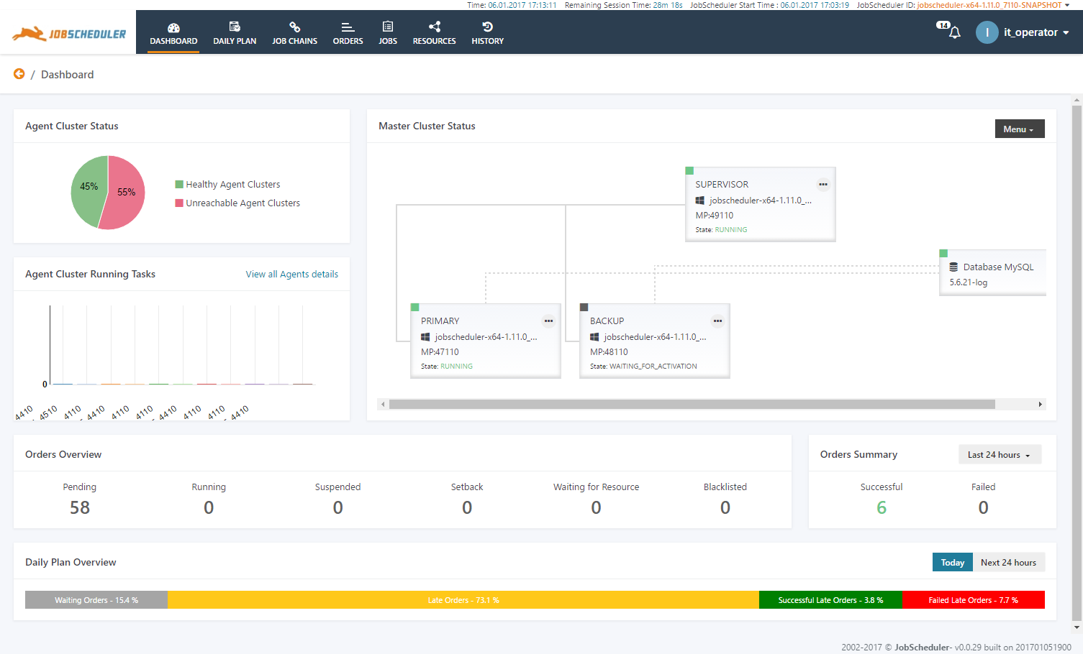
Interfaces and Key Features: User Interfaces
JOC Cockpit - Dashboard
Dashboard
The Dashboard offers a comprehensive overview of most relevant information in the form of widgets
Information in the Dashboard is updated automatically in near real-time
The Dashboard shows the JobScheduler Master status including cluster information
The Agent overview shows healthy and unhealthy Agent Clusters
The Dashboard is a starting point to navigate to objects of interest, e.g. failed orders, suspended orders, late orders etc.

Slide 22
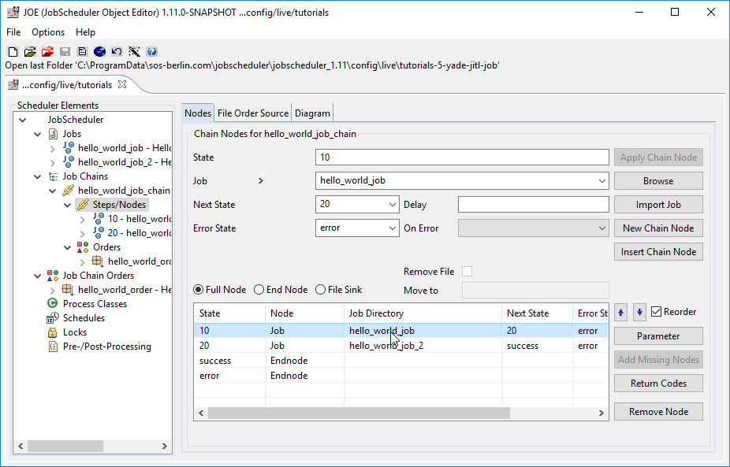
Interfaces and Key Features: User Interfaces
JOE Object Editor - Job Management
JOE Job Editor
JOE is used to create, configure and manage JobScheduler objects such as jobs, job chains, orders, schedules, process classes and locks
JOE reads and writes XML files for objects to so-called hot folders where they are loaded by JobScheduler
JOE can be operated directly in the schedu-ling environment or on any computer that supports a Java Virtual Machine

Slide 23
Interfaces and Key Features: Programming Interfaces
REST Web Service Interface
JobScheduler
Programming Interfaces
JobScheduler REST Web Service
Permissions
JOC Cockpit
JOC Cockpit REST Web Service
Permissions
JobScheduler REST Web Service (XML)
The JobScheduler comes with a powerful REST Web Service interface for access by external applications
This interface is used for tasks such as adding orders, adding events and retrieving job and order status information
Access to the REST Web Service is restricted by permissions
JOC Cockpit REST Web Service (JSON)
The JOC Cockpit comes with a REST Web Service interface for JSON
This interface is used for access to the job inventory and the job history as well as individual objects such as jobs, job chains and orders and provides current status information
Access to the REST Web Service is restricted by permissions

Slide 24
Interfaces and Key Features: Programming Interfaces
Job Application Programming Interface
More Information
API Interface
Reference Documentation
Areas of Operation
The JobScheduler comes with an extensive set of objects and methods for implementation with jobs and monitors. Such implementations often make use of the API Interface to check and manipulate JobScheduler objects, e.g. to add orders, to modify the order and job status
The API is available for jobs and monitor scripts that implement conditions for job execution
Language Support
The API is available for scripted jobs, e.g. in the languages JavaScript, PowerShell, VBScript
The API can be used from Java jobs

Slide 25
Interfaces and Key Features: Programming Interfaces
Command Line Interface
More Information
Command Line Operation
PowerShell Command Line Interface
Shell Command Line Operation
The JobScheduler can be operated from the command line, allowing a wide range of operations to be carried out by an external application:
checking the JobScheduler status
controlling the status of jobs, job chains and orders
adding orders to job chains
adding events for event handling
PowerShell Command Line Interface
The JobScheduler Command Line Interface (JCLI) can be used to control JobScheduler instances (start, stop, status) and job-related objects such as jobs, job chains, orders, tasks
Areas of Operation include to
work as a replacement for command scripts, e.g. to start JobScheduler and to raise events
provide bulk operations on jobs, job chains and orders
schedule jobs and orders
manage Agents, e.g. to check the Agent status

Slide 26
Interfaces and Key Features
Key Features (1/4)
More Information
Start Times
Logging
Scripting
Start Times
Time events are one way of starting jobs, job chains and orders, with Start Times being set for a predefined point in time such as time of day, weekday, day of month etc.
Logging
The JobScheduler creates a number of logs to provide specific information about jobs, job chains, orders, tasks and JobScheduler installation and operation
Scripting
Scripting interface that allows execution of scripts in languages such as JavaScript, etc.

Slide 27
Interfaces and Key Features
Key Features (2/4)
More Information
Jobs, Job Chains and Orders
Error Handling
Event Handling
Jobs, Job Chains and Orders
The JobScheduler's unique job and order concept includes the organization of jobs into job chains and the use of dependencies
Jobs: basic unit for the processing of executable files
Job Chains: assembly line on which job nodes are passed sequentially
Orders: represent triggers that will cause a job chain to be started
Error Handling
A number of methods for error handling are available, e.g. stop a job, suspend an order, setback an order and more
Event Handling
Mechanism for implementing complex dependencies between jobs or between jobs and external events

Slide 28
Interfaces and Key Features
Key Features (3/4)
More Information
Central Configuration
Directory Monitoring and File Watching
Resource Contention Manager
Central Configuration
Central configuration allows the efficient distribution of configuration files from a central source to distributed JobScheduler instances by use of a Supervisor JobScheduler
Directory Monitoring and File Watching
Two methods to start jobs and job chains automatically based on the arrival of incoming files
Resource Contention Manager
Process classes and locks are used to manage the use of resources such as databases or printers

Slide 29
Interfaces and Key Features
Key Features (4/4)
More Information
Notifications
Monitoring
Localization
Notifications
JobScheduler comes with its own mail client which it can use to send notifying e-mails in the event of, for example, jobs ending in error
Monitoring
JobScheduler can be monitored by System Monitors. Such products include e.g. HP OpenView®, Microsoft SCOM®, Nagios®, op5®, Opsview®, Zabbix® etc.
Localization
Language files are provided for the installation of JobScheduler and for most of its operating interfaces. The default language is English
Installation Languages: English and German
Interface Languages: English, French, German, Japanese

Slide 30
High Availability: Overview
Implementation for High Availability and Fault Tolerance
More Information
Cluster Operation
Fault Tolerance
Master / Agent Resilience
Master / Agent Redundancy
Recovery Strategies
Cluster Operation
Master and Agents are available for Active and Passive Clusters
Fault Tolerance
Resilience and Redundancy provide high availability of JobScheduler for a number of outage scenarios
Master / Agent Resilience
measures for operational robustness, such as Master/Agent Reconciliation, Master Service Recovery, Database Service Recovery
Master / Agent Redundancy
includes a number of architecture decisions for Master Clusters and Agent Clusters
Recovery Strategies
provide an overview of means how to restore the scheduling service

Slide 31
High Availability: Agent Cluster
Agent Cluster: Fixed Priority and Round-Robin Scheduling
Master/Agent Platforms
JobScheduler Master is available for Windows and Linux
JobScheduler Agents are available for any platform that supports a Java Virtual Machine
Agent Cluster
Agents can be con-figured to work in a Cluster
Fixed Priority Scheduling
JobScheduler Master selects the first available Agent from a Cluster for job execution
Should an Agent not be available then the next available Agent is used
Round-Robin Scheduling
JobScheduler Master switches the Agent used for each job execution
Should an Agent not be available the next available Agent is used
Database
access database
JobScheduler Master
Windows
Works with the JobScheduler Master platforms:
Windows
Linux
Enables job execution
on JobScheduler Master instances
on JobScheduler Agents for any platform
JobScheduler Master
Linux
Works with all supported databases:
Oracle
SQL Server
DB2
MariaDB
MySQL
PostgreSQL
JobScheduler
Agent
... any platform
JobScheduler
Agent
... any platform
JobScheduler
Agent
... any platform
JobScheduler
Agent
... any platform
JobScheduler
Agent
... any platform
JobScheduler
Agent
... any platform
Works with any platform that supports a Java Virtual Machine
Works with any platform that supports a Java Virtual Machine

Slide 32
High Availability: Master Cluster
JobScheduler Master Passive Cluster
Passive Cluster
Primary and Backup JobScheduler Master use the same database
Primary JobScheduler Master is monitored by its failover instance
Failover instance operates in stand-by mode
All connections to servers use the SSH protocol
SSH Connections
JITL Jobs
Requires a JVM per task
Memory resources
SSH Client
No pre- and post-processing
No substitution of parameters in script files
Script files have to be provided on the target system
Share or Supervisor JobScheduler
access configuration
access configuration
Database
access database
Primary JobScheduler JS1
passive stand-by
Backup JobScheduler JS2
connect via ssh
connect via ssh
Agent JobScheduler SVR1
Agent JobScheduler SVR2
Agent JobScheduler SVR3

Slide 33
High Availability: Master Cluster
JobScheduler Master Active Cluster
Master/Agent Active Cluster
JobScheduler Cluster members use the same database
JobSchedulers Cluster members share the workload of jobs
All instances operate in active mode
All Cluster instances use Agents to execute jobs on remote servers
Job Execution
Jobs are executed locally with the JobScheduler Agent.
No central resources required for job execution
Pre-/post-processing
Use of JITL Jobs or script files with parameter substitution
Share or Supervisor JobScheduler
access configuration
access configuration
access configuration
Database
access database
Active Cluster JobScheduler JS1
Active Cluster JobScheduler JS2
Active Cluster JobScheduler JS3
connect via JobScheduler protocol
connect via JobScheduler protocol
connect via JobScheduler protocol
Agent JobScheduler SVR1
Agent JobScheduler SVR2
Agent JobScheduler SVR3

Slide 34
High Availability: Supervisor JobScheduler
JobScheduler Supervisor for Passive and Active Cluster
Master/Agent Active Cluster
JobScheduler Cluster members use the same database
JobScheduler Cluster members share the workload of jobs
All instances operate in active mode
All Cluster instances use Agents to execute jobs on remote servers
Supervisor JobScheduler
Distribute configuration to Cluster JobScheduler instances
Supervisor JobScheduler JS4
Share or File System
distribute configuration
distribute configuration
distribute configuration
Database
access database
Active Cluster JobScheduler JS1
Active Cluster JobScheduler JS2
Active Cluster JobScheduler JS3
connect via JobScheduler protocol
connect via JobScheduler protocol
connect via JobScheduler protocol
Agent JobScheduler SVR1
Agent JobScheduler SVR2
Agent JobScheduler SVR3

Slide 35
JobScheduler in a Nutshell
Open Source JobScheduler
Software- und
Organisations-
Service GmbH
Giesebrechtstr. 15
D-10629 Berlin
Germany
sales@sos-berlin.com
www.sos-berlin.com
Questions?
Comments?
Feedback?

